Slide 1
Getting started with secondary data analysis:
Dr Ana Morales-Gomez
Introduction to analysing data about crime using R
Manchester
4-5 February 2020

Slide 2
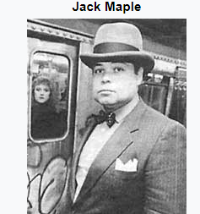
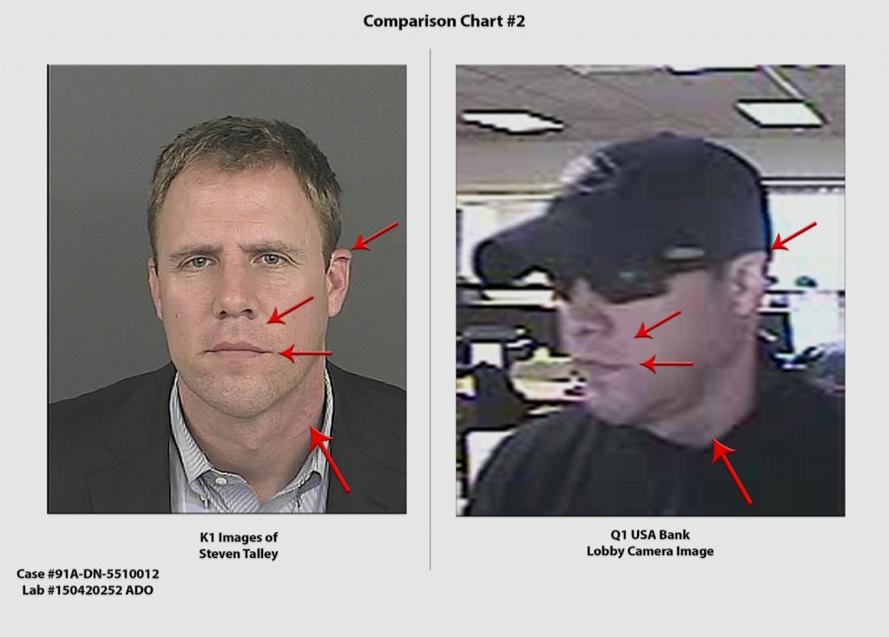
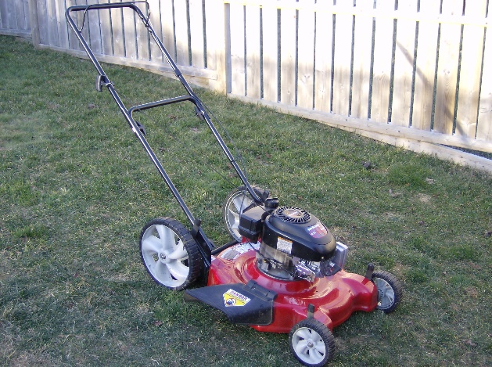
Data and Crime
Jack Maple and the “Charts of the Future”
Steve Talley: How facial recognition can ruin your life
Paul Zilly: Human versus Machine
Jack Maple: https://en.wikipedia.org/wiki/Jack_Maple
Steve Talley: https://theintercept.com/2016/10/13/how-a-facial-recognition-mismatch-can-ruin-your-life/
Paul Zilly: https://www.sciencefocus.com/future-technology/can-an-algorithm-deliver-justice/

Slide 3


More about Data and Crime
Chapter Justice
Chapter Crime
Twitter: @FryRsquared

Slide 4
What is Research?
Adding a contribution to an existing body of knowledge
Notes:
No consensus for a single answer

Slide 5
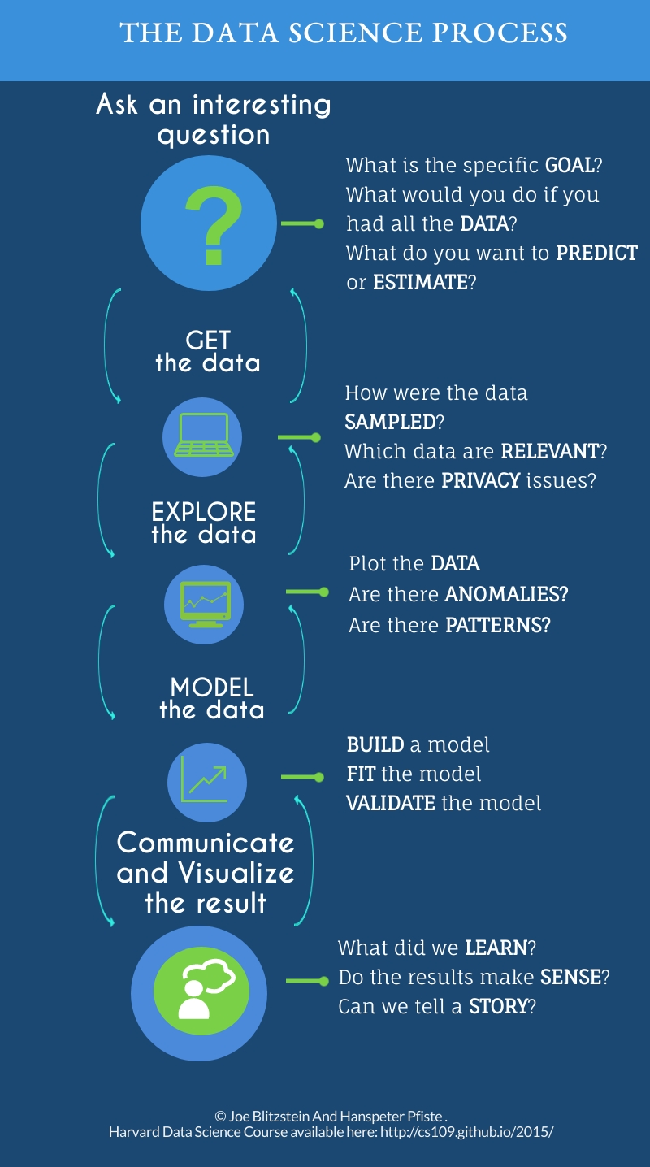

Slide 6
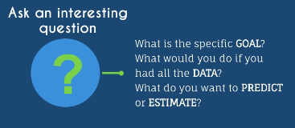
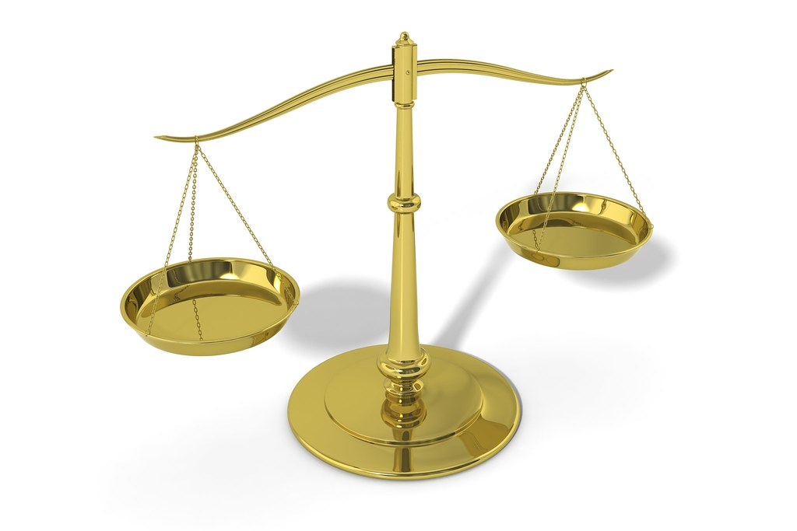
The data Science process (1): Ask an interesting question
A topic of interest:
Crime
Health inequalities
Pollution
Specific goal
Confidence in the Criminal Justice System in England
Antisocial behaviour in Manchester
What do you want to predict or estimate?
National level estimates
Local level indicators
CJS as a whole or concentrate on Police, prisons, Sentencing?

Slide 7
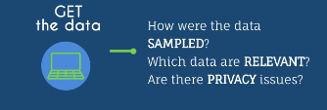
The data Science process (2): Get the data
Police recorded crime data
CSEW: For England and Wales
Scottish Crime and Justice Survey
European Social Survey
Others:
Administrative data of prisons
Administrative data sentencing council

Slide 8
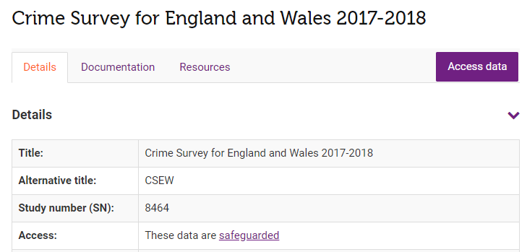
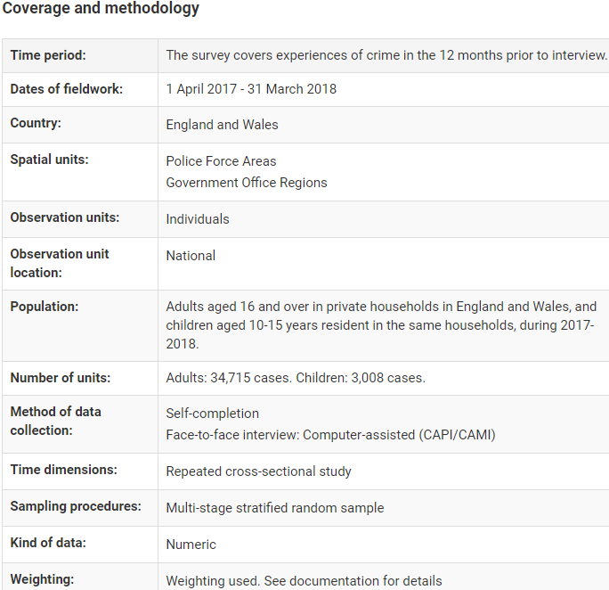
The data Science process (2): Get the data
Police recorded crime data:
CSEW UK Data Service
Coverage
Date range
Spatial units
What data
Available for surveys
Open data may not have any
Format
Depending on the source. UKDS: Stata, SPSS,
Excel
Text

Slide 9
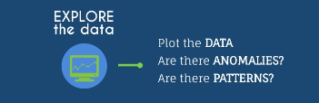
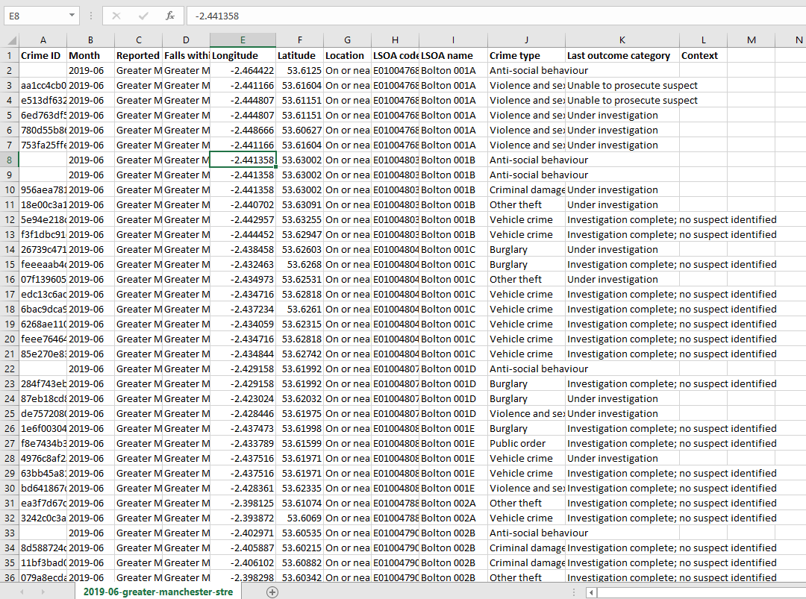
The data Science process (3a): Explore the data
What data do we have?
Variables
Type of data
Numeric?
Attribute (character)
Is it ready to analyse?
Data cleaning
Manipulation

Slide 10
The data Science process (3b): Explore the data
What data do we have?
Variables
(name some variables)
Type of data
Numeric?
Attribute (character)
Is it ready to analyse?
Data cleaning
Manipulation
Descriptive statistics
Central tendency measures
Any correlations?
Anomalies?
Plot the data
Anomalies?
Patterns?
More questions
Are the data enough for my RQ?
Do we need more data?
Is there more data?
Change RQs?

Slide 11
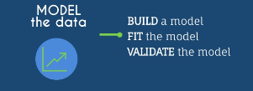
The data Science process (4): Model the data
What is the best approach to understand the data we have?
Depends on…
Our research questions
Our data available
Example:
Correlation to look for association of two variables
Generalised Linear models /Regression based models for
Multiple linear regression (continuous outcome)
Logistic/Probit regression (binary outcome)
Ordinal regresions
Multilevel models (clusters and hierarchy dependence)
Longitudinal models (samples at different time points)

Slide 12
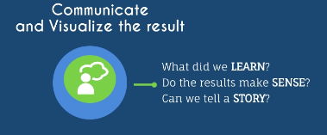
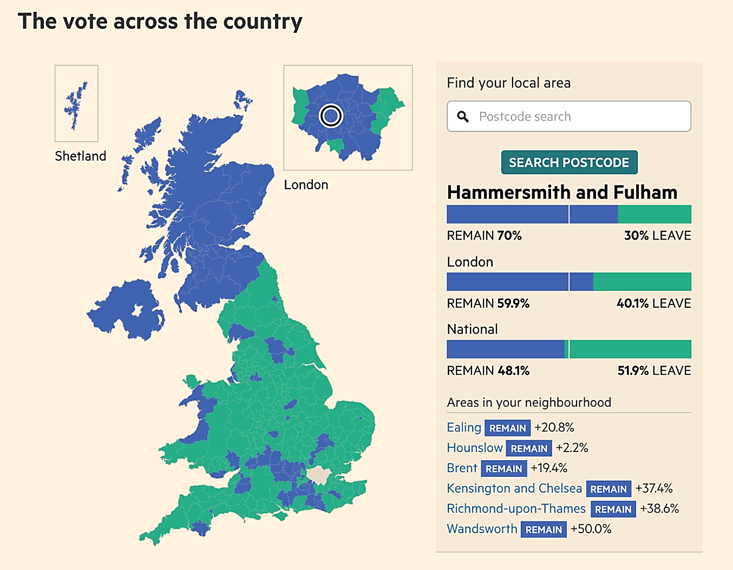
The data Science process (5): Communicate and visualise the results
Visualise the results
Tables
Figures
Plots
Maps
Communicate the results
Know your audience
Effective
The right details for each audience
Academic ≠ Local Government officers
Brexit Referendum
Source: Financial Times: https://ig.ft.com/sites/elections/2016/uk/eu-referendum/

Slide 13
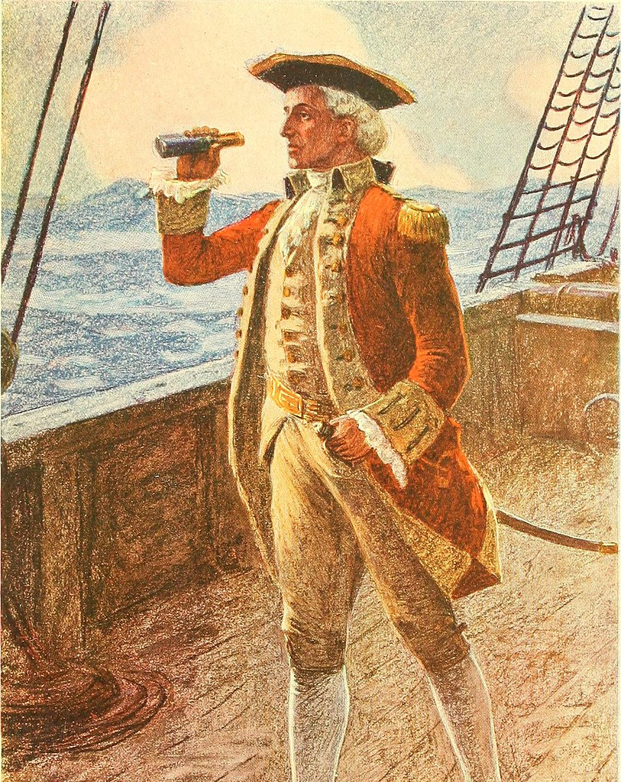
Exploratory Data
Analysis

Slide 14
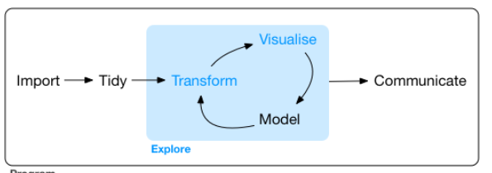
Exploratory data analysis
Flowchart for data preparation
From R for data science
https://r4ds.had.co.nz/explore-intro.html

Slide 15
What is data?
Information, especially facts or numbers, collected to be examined and considered and used to help decision-making, or information in an electronic form that can be stored and used by a computer (Cambridge dictionary)
Numeric
Images
Attributes (characters)

Slide 16
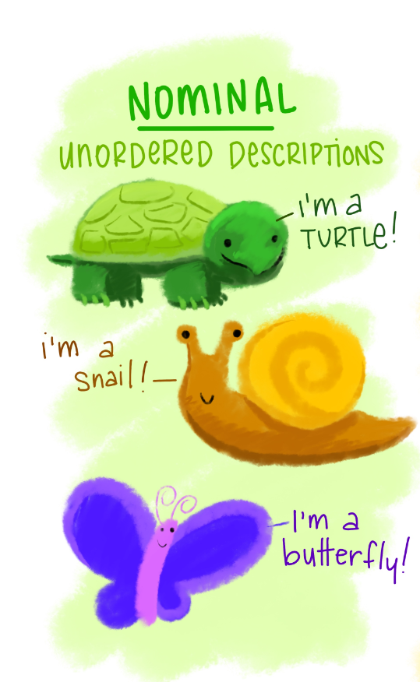
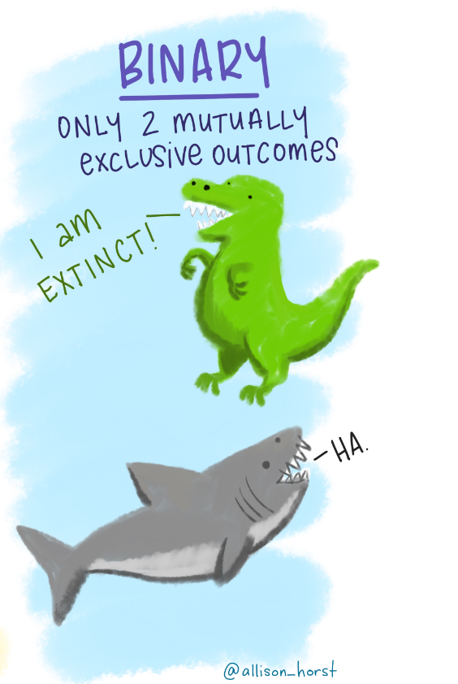
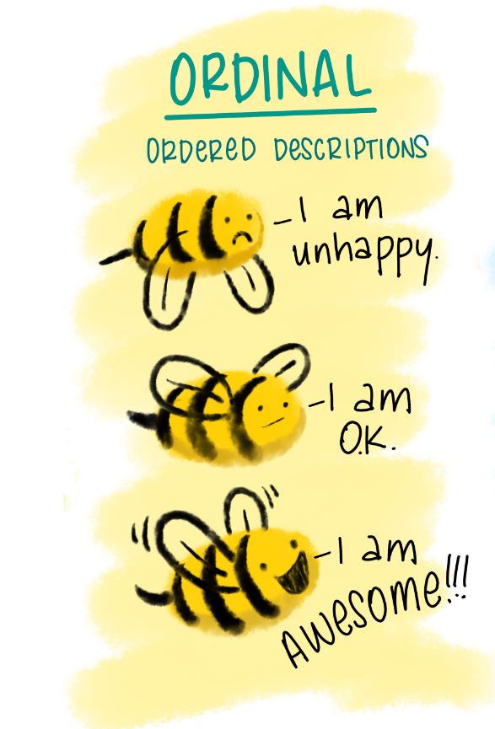
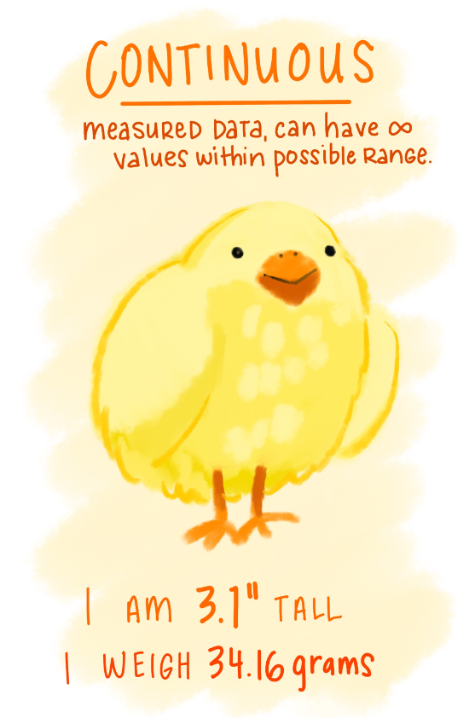

Figures: © Allison Horst

Slide 17
Describe the data
To Understand:
data availability,
Types,
quality,
data complexity (i.e. nonlinearity, requires transformation, etc)
Guided by two types of questions (Grolemund and Wickham, 2016):
What type of covariation occurs between my variables?
What type of variation occurs within my variables?
Notes:
To develop an understanding of the data. Two key questions lead this search

Slide 18
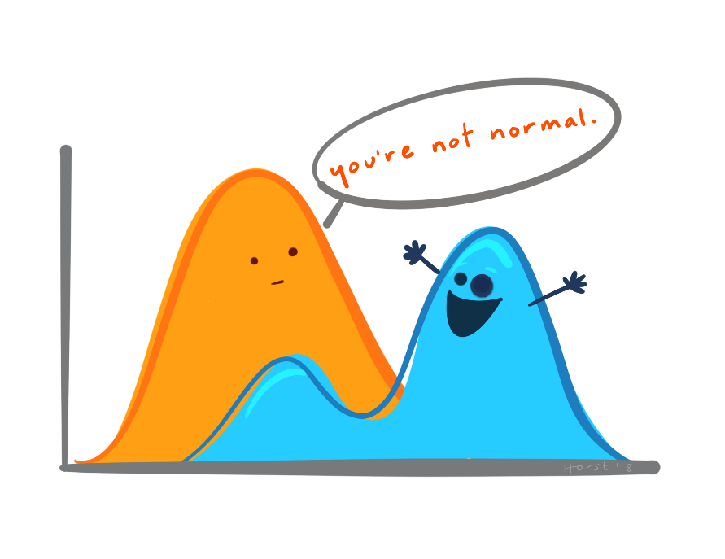
How to describe the data (1)
Distribution of numerical variables:
Extreme values (outliers)
Shape of the distribution
Missing cases
Unusual patterns
Distribution of categorical variables
Missing cases
Odd values
Unusual patterns
Most common values
Figure: © Allison Horst
Notes:
Mean, median, and mode are different measures of center in a numerical data set. They each try to summarize a dataset with a single number to represent a "typical" data point from the dataset.

Slide 19
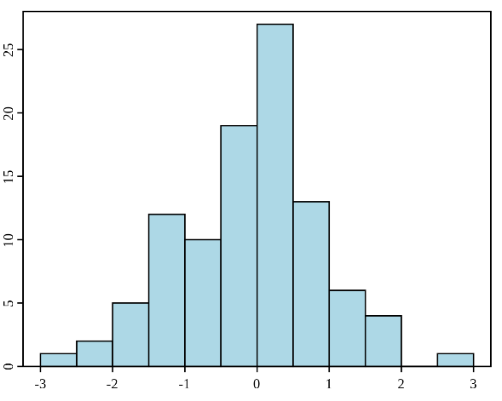
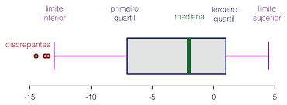
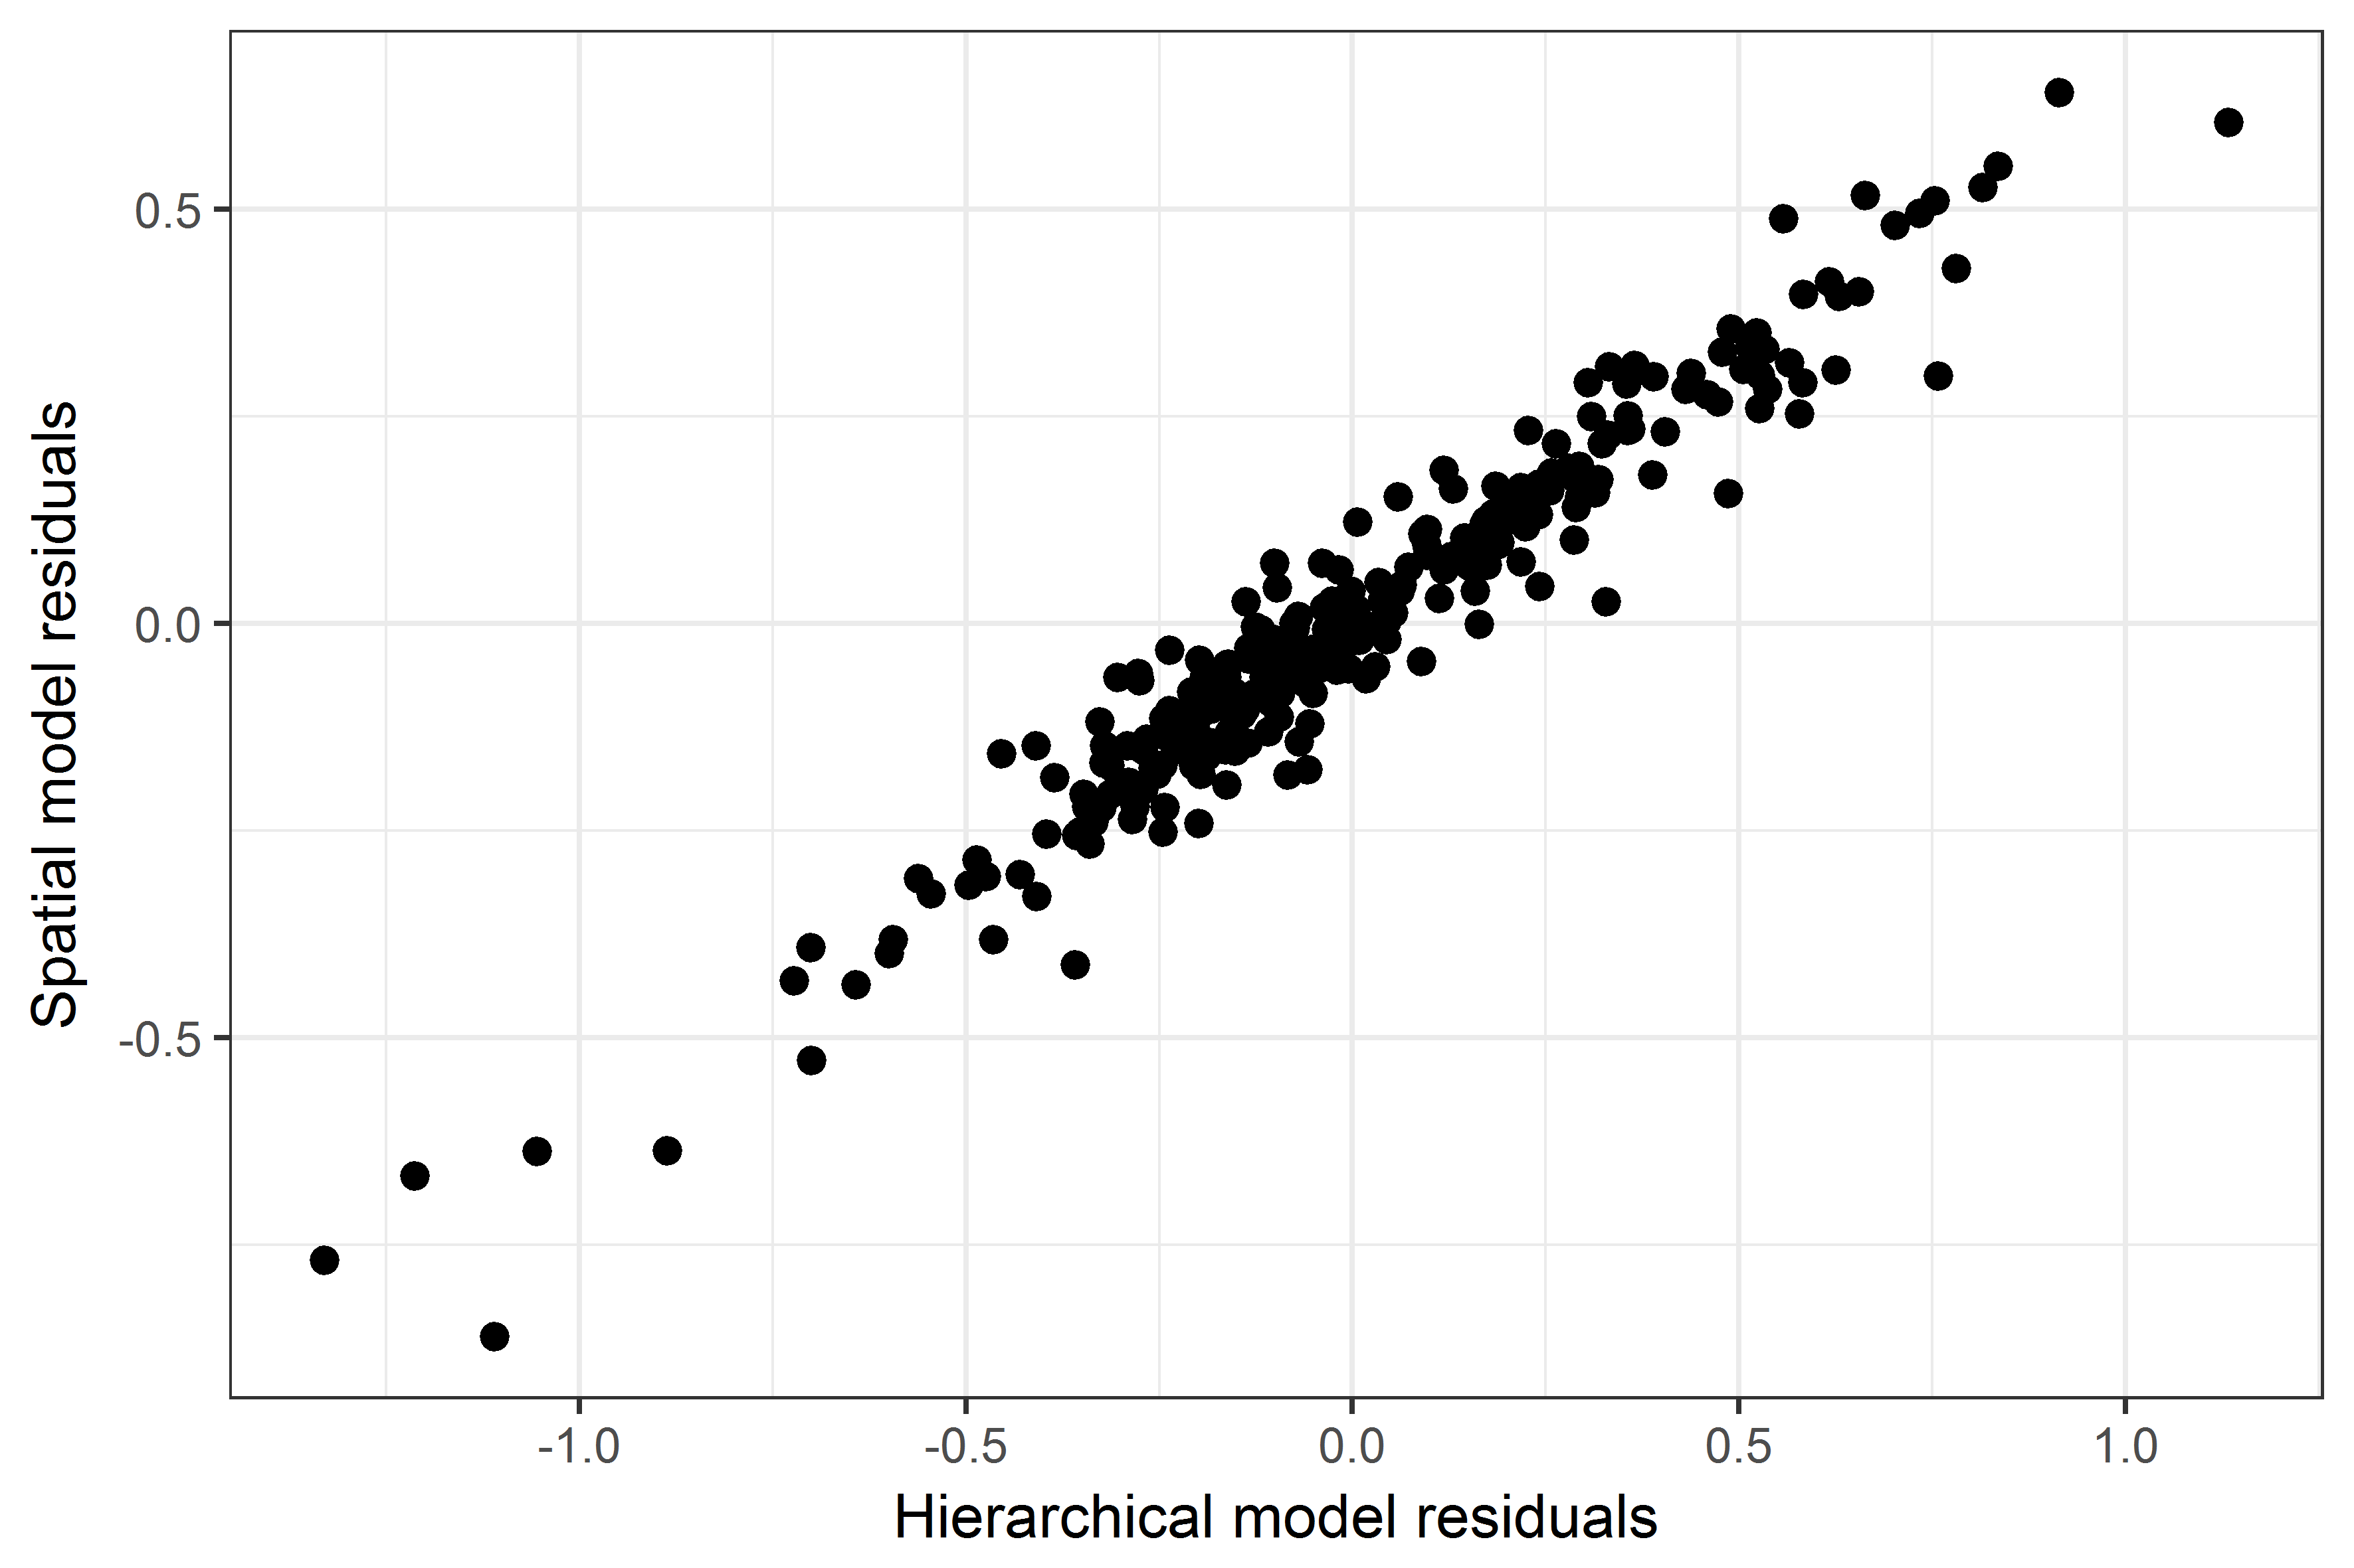
How to describe the data (2)
Central tendency measures
Mean
median
mode
Measures of spread
Variance and standard deviation
Range:
Interquartile range (IQR)
Visualisations
Histograms, boxplots, bar plots, scatterplots

Slide 20
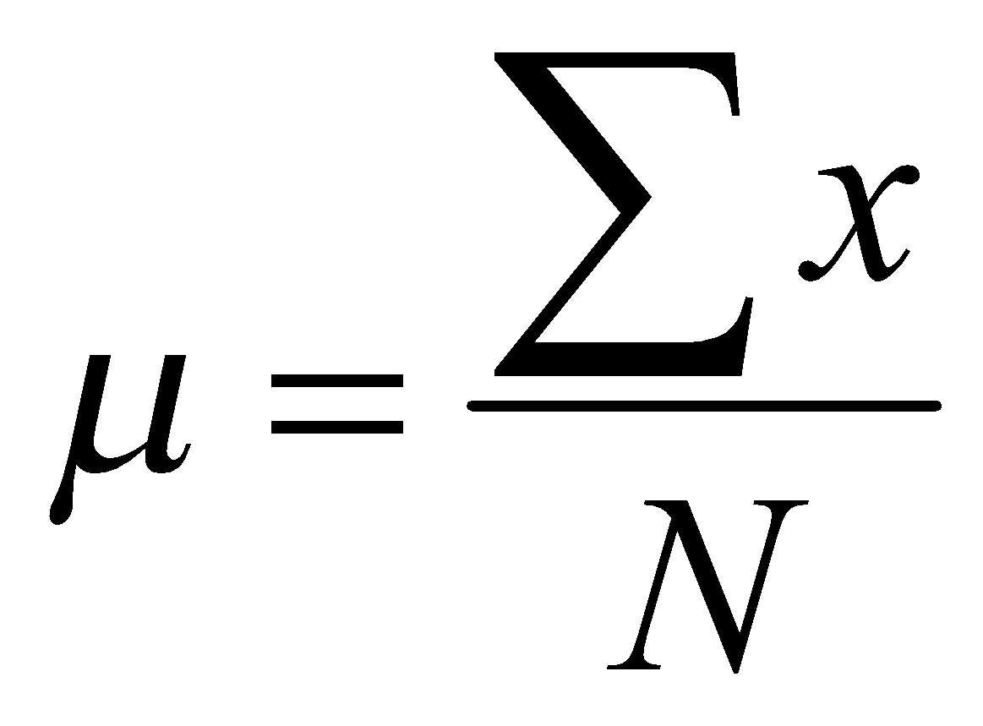
How to describe the data (3)
Mean (sample vs. population):
The "average" number; found by adding all data points and dividing by the number of data points
Median
Middle value if odd number of values, or average of the middle two values otherwise
Mode
Value that occurs most frequently in the data
Unimodal, bimodal, trimodal
Is the mean always the best central tendency measure?
Notes:
Mean and median both try to measure the "central tendency" in a data set. The mean is commonly used, but sometimes the median is preferred.
For categorical data the mode makes more sense

Slide 21
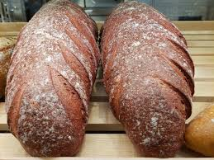
The problem with the mean
“There are two pieces of bread. You eat two. I eat none. Average consumption: one bread per person.“
Nicanor Parra, (Anti)Poet, Mathematician and Physicist
Notes:
Mean and median both try to measure the "central tendency" in a data set. The mean is commonly used, but sometimes the median is preferred.
In cases with highly skewed distribution or outliers, the mean doesn’t represent the typical value very well and it can be misleading
The mean is sensitive to extreme values

Slide 22
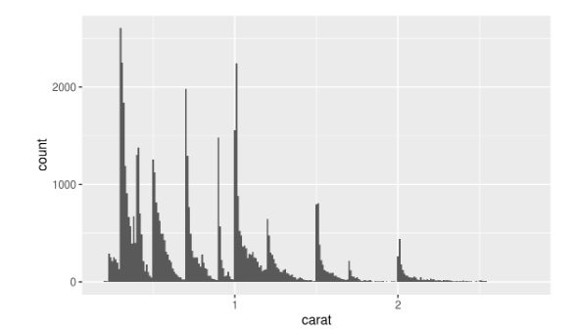
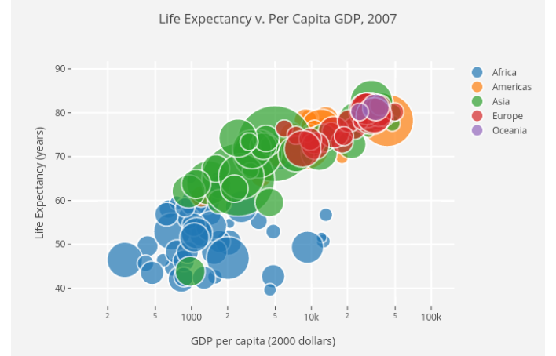
More about visualisations
Two types:
Exploring and getting to know the data
Assess the data: decide what to do next
Accurate
Internal, never reach the wider audience
Communication
Present data and ideas
Accurate: provide evidence
Easy to understand
Effective
It would depend on the audience
Images: https://r4ds.had.co.nz/exploratory-data-analysis.html
https://towardsdatascience.com/5-quick-and-easy-data-visualizations-in-python-with-code-a2284bae952f
Notes:
Explore the data
Assess a situation
Determine how to proceed
Decide what to do
Communicate:
Present data and ideas
Explain and inform
Provide evidence and support
Influence and persuade

Slide 23
Effective visualisations for communication
Simple but effective (don’t over do it!)
Easy to understand
Use the right type of graph of figure
Not a fit them all purpose graph
Appropriate use of colours (colour blind people)
Know your audience
Notes:
Know your audience:
What do they know?
• What motivates them? What do they desire?
• What experiences do you share? What are
common goals?
• What insights can you give them? What tools
and “magical gifts”?

Slide 24
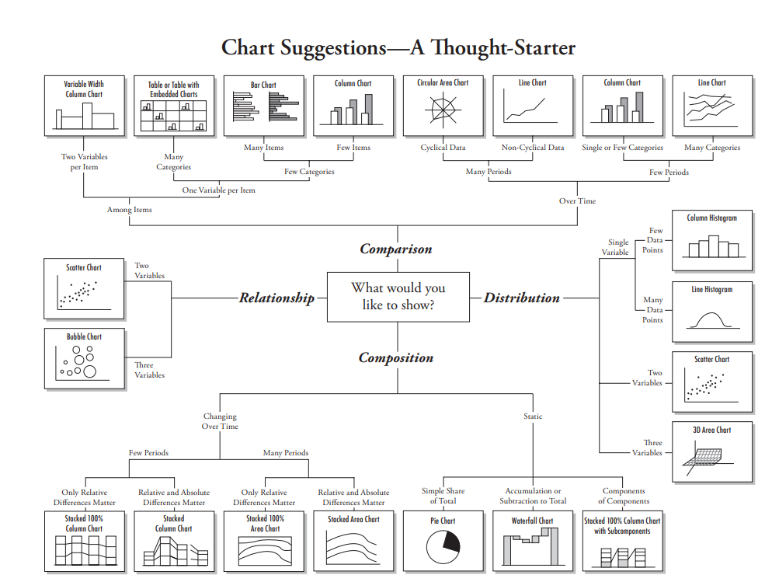
Effective visualisations for communication
https://extremepresentation.typepad.com/blog/files/choosing_a_good_chart.pdf

Slide 25
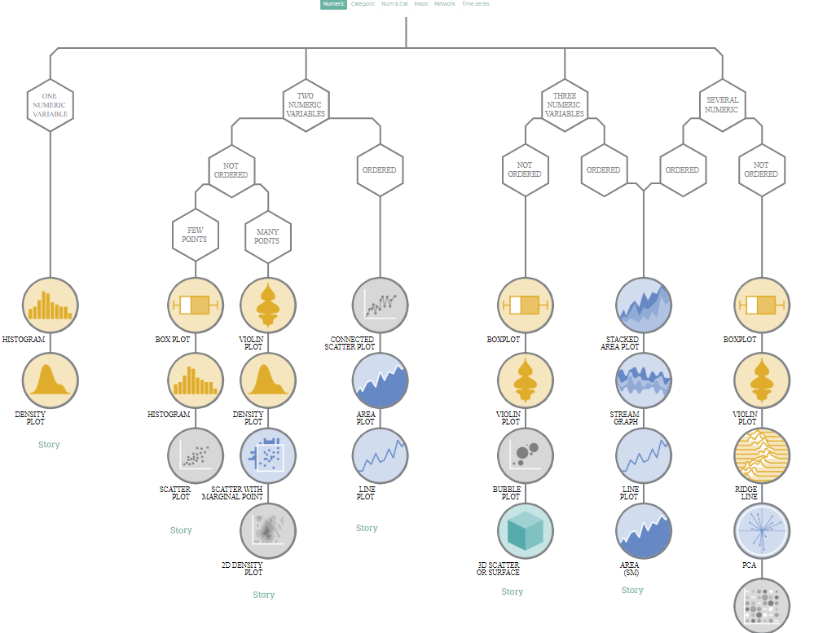
https://www.data-to-viz.com/

Slide 26
Effective visualisations for communication: Use the right display
Comparisons:
Bars
lines
Proportions
Pie charts
Stacked charts
Trends over time
Lines
Scatterplots
Distributions
Density plots
Histograms
Correlations
Scatterplots
Notes:
A scatter plot is a way to visualize how multi-dimensional data
are distributed across certain values.
A scatter plot is also a way to visualize the relationship between
two different attributes of multi-dimensional data.
A histogram is a way to visualize how 1-dimensional data is
distributed across certain values.
A pie chart is a way to visualize the static composition (aka,
distribution) of a variable (or single group).
A stacked area graph is a way to visualize the composition of a
group as it changes over time (or some other quantitative
variable).
A boxplot is a simplied visualization to compare a quantitative
variable across groups. It highlights the range, quartiles, median
and any outliers present in a data set.

Slide 27
Your turn

Slide 28
Ana Morales-Gomez
ana.morales@Manchester.ac.uk

